Slide 1

YOUR VOICE TEAM-1
RITU SOLANKI
KIRTISHIL NANA PATIL
GANESH ASHOKRAO DHOLE
AMIT BABARAO DODAKE

Slide 2

A Review and Giving Ratings Website
Your Voice will be a website for general public to Voice their views on various kind of mobile phones from old model phones to latest smart phones of different categories .
Also they can give ratings to the products used.
People especially during lockdown period prefer watching movies , suggesting it to their friends. So, our website helps them in getting honest revies of these movies .
This website also allows people to add reviews anonymously or they can also disclose their identities.

Slide 3
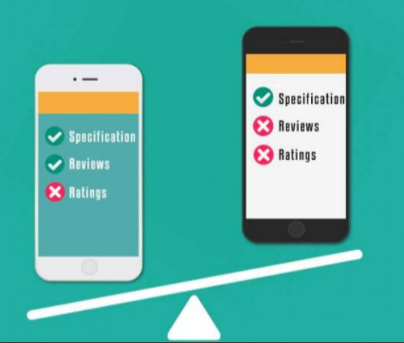
WHY “YOUR VOICE” WEBSITE IS THE BEST?
Read genuine and unbiased consumer reviews
Compare products
Write honest reviews to help others
Different categories of mobile phones and various genres of movies

Slide 4
CATEGORIES
MOBILE PHONES
MOVIES
“Your Voice” Website will be a common platform for all general public to review mobile phones and movies.

